Slide 1

THE LAST DANCE -MOVIE RECOMMENDER SYSTEMS
Jain, Nitesh
Lakshmanan, Veldurai
Munipalle, Amar
Sooriyakumar, Sinthushan

Slide 2
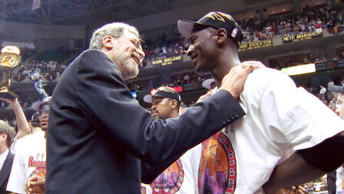
WHY – THE LAST DANCE
Championship 1 - Problem Definition
Championship 3 – Data Cleansing
Championship 4 - Machine Learning
Championship 5 - Reasonableness
Championship 6 - Iterate
Championship 2 - Data Sourcing
Last rodeo which samples greatest hits of previous rodeos
Image sourced from www.netflix.com

Slide 3
Executive Summary
Movie recommender system leveraging key machine learning and mathematical concepts
Building Blocks
Collaborative
Content Based
Hybrid
Approach
Collaborative – data sourcing, cleansing and correlation-based analytics at movie level
Content – data sourcing, cleansing and analysis of past ratings
Outcome
Peek into a $ billion ‘recommender’ industry → core concepts identical between a KAGGLE workbook and Netflix
Conviction based recommendations for all three approaches
Clear set of steps to improve and enhance

Slide 4
Strategic Building Blocks
CONTENT AND COLLOBORATIVE FILTERING CONCEPTS
TUNING AND MODEL PERFORMANCE
REASONABLENESS CHECKS

Slide 5
Overview
Problem
Build a recommender system
Data Sources
Movie Lens Dataset (Large and Small)
100,000 ratings applied to 9,000 (~3000 used) movies by 670 users
Data Selection
Minimum rating thresholds where applicable
Cross reference movie IDs between metadata and ratings
45,000 meta data points
Data Cleaning
Pandas
Excel
Data Transformation
numpy; sparse matrices
Analyze
Correlations, linear algebra
Evaluate
Cross validate across algorithms

Slide 6
The Big Picture
Special Thanks:
https://towardsdatascience.com/build-recommendation-system-with-pyspark-using-alternating-least-squares-als-matrix-factorisation-ebe1ad2e7679
Breaking down a very large matrix into 3 smaller matrixes
 | Bank Job | Baasha | The Godfather | Movie 1,32,000
User 1 | 5 | 5 | 5 | 4
User 2 | 3 | 1 | 3 | 1
User 3 | 5 | 4 | 5 | 4
User 1,00,000 | 4 | 2.5 | 4 | ?
Matrix W –movie specific
 | BankJob | Baasha | Godfather
Action | 3 | 4 | 3
Rom | 2 | 1 | 2
Matrix U –user (Action vs Rom)
1 | Y | Y
2 | N | Y
3 | Y | Y
1m | Y | Y
Collob
Matrix V – rating prediction
User 1 | 5 | 5 | 5
User 2 | 2 | 1 | 2
User 3 | 5 | 5 | 5
Content
Content Based: Recommend items similar to those that have been liked e.g. correlation between movies
Collaborative: Aggregate past behavior
Recommendation System
Content Based
Collaborative
Memory Based
Model Based
Hybrid
SVD
ALS
SLS
Regression + complex linear algebra + PCA on steroids

Slide 7
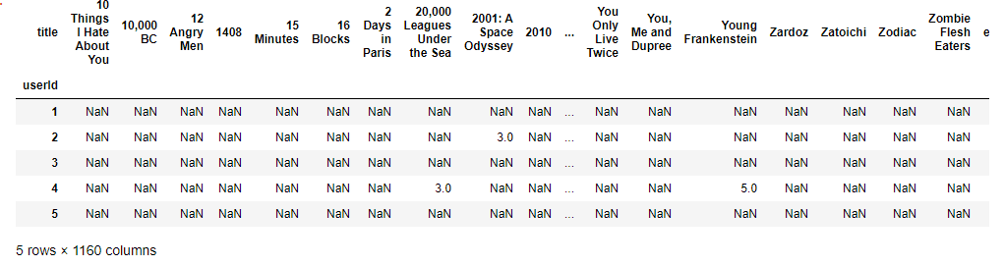
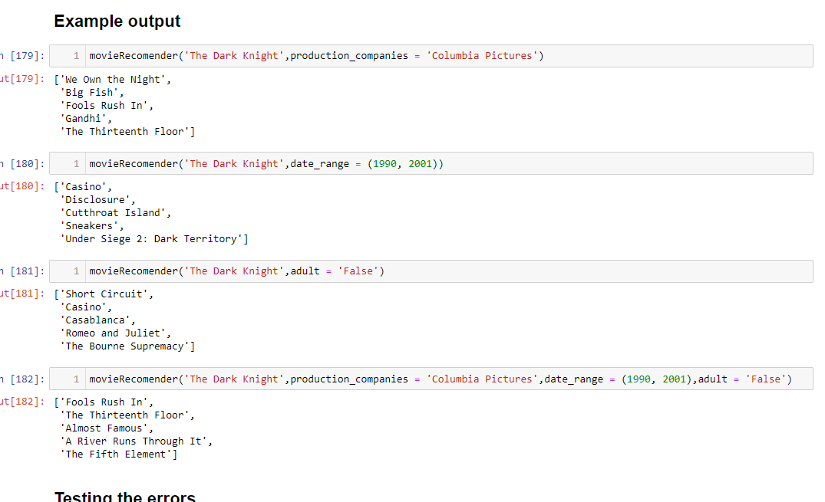
Approach 1: Correlation
Concept
Correlation matrix of users and movie ratings
Data
Pairwise for all movies
Deduce correlations for particular movies.
Output
Recommender System
Generate similarities and supply
Pearson correlations
Special Thanks:
https://medium.com/analytics-vidhya/simple-movie-recommender-system-with-correlation-coefficient-with-python-e6cb31dae01e

Slide 8
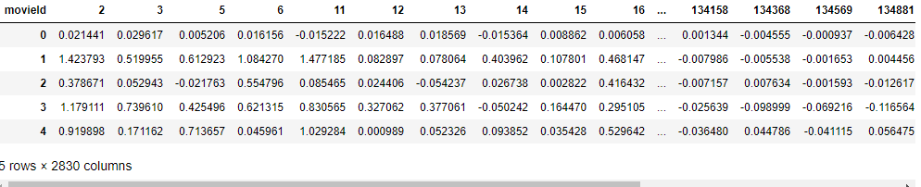
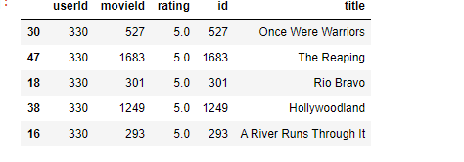
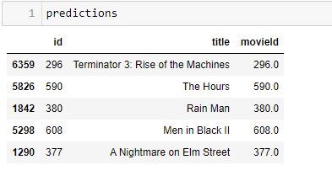
Approach 2: Collaborative – Singular Vector Decomposition
Concept
Users similar to a user will like similar movies
Math
Dimensionality Reduction
Starts with a matrix of 700x9000 (700 users, 9000 movies)
Output
Recommender System
Derived from decomposed matrices
Birds of same feather flock together
A = USV^{T}
Matrix U: latent factors; Matrix S: strength of each latent factor; Matrix U: singular matrix of (item*latent factors)
LIKED
PREDICTED
Special Thanks:
https://towardsdatascience.com/recommender-system-singular-value-decomposition-svd-truncated-svd-97096338f361#:~:text=Recommending%20movies%20using%20SVD,features%20of%20item%2Duser%20matrices
https://www.kaggle.com/rounakbanik/movie-recommender-systems

Slide 9
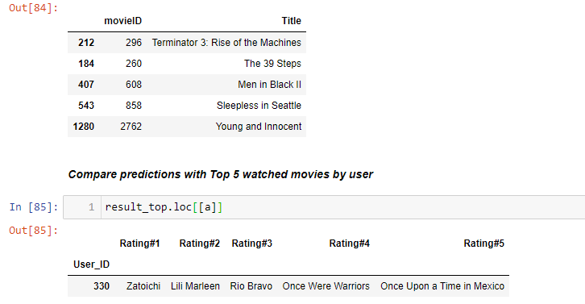
Approach 3: Collaborative – ALTERNATE LEAST SQUARES
Concept
Similar concept to SVD
Math
Dimensionality Reduction
Break matrix into two sub-sets
Output
Recommender System
Derived from decomposed matrices
Birds of same feather flock together
Computationally extremely intensive
Several deployments using PySpark
Special Thanks:
https://www.kaggle.com/subhamoybhaduri/diff-approaches-of-building-recommender-system
https://www.kaggle.com/rounakbanik/movie-recommender-systems

Slide 10
Our biggest obstacle – sparseness of DATA. MOST MOVIES ARE NOT RATED SOLUTION – FROM scipy.sparse.linalg import spsolve, svds

Slide 11
LESSONS LEARNT
Always query the data before starting work → nearly 80% of movies in our ratings database lacked meta-date (e.g. title). There was no way to check validity of recommendations
SVD performed best → but good intersection between SVD and ALS
KAGGLE, MEDIUM and TOWARDSDATASCIENCE are absolutely essential
Acknowledgements in respective slides
Try doing some KAGGLE problems
$50 on MEDIUM subscription is money well spent
PANDAS → Out of Sight; Out of Mind → PRACTICE, PRACTICE
At some point we struggled with a simple merge
A PySpark implementation and more tuning will dramatically improve performance → possible next step when we enrol in Fintech II

Slide 12
RECAP
WE SET OUT TO BUILD A MOVIE RECOMMENDER….
….WE RESEARCHED CONTENT AND COLLOBORATIVE
CONTENT BASED ARE EASIER TO IMPLEMENT
…..MORE INTUITIVE
…..DOES NOT SUFFER FROM COLD START PROBLEMS
COLLOBORATIVE ARE MORE COMPLEX
….BUT VERY BASICALLY A DIMENSIONALIT REDUCTION TECHNIQUE
WHAT WE HAVE AT A BASIC LEVEL IS NOT FAR OFF FROM INDUSTRY
….BUT THE REAL VALUE IS IN THE DATA, HYPERTUNING etc. which we have not fully harnessed
…..THIS IS THE SECRET SAUCE FOR INDUSTRY

